Slide 1
CSS
POSITIONING

Slide 2
Positioning Rules:
Sometimes you want an element to appear at a particular distance from the edges.
You can then specify the elements where on the page they should appear. (top, right, bottom, or left)
The position property specifies the type of positioning method used for an element (static, relative, fixed, absolute, or sticky).
Elements are then positioned using the top, bottom, left, and right properties. However, these properties will not work unless the position property is set first. They also work differently depending on the position value.
Top, right, left or bottom will not work if the position is not set.
These (top, right, bottom, left) will not have an effect on statically positioned elements

Slide 3
STATIC POSITIONING
An element with position: static; is not positioned in any special way, it is positioned according to the normal flow of the page. Static positioned elements are not affected by the top, bottom, left, and right properties.
Note: HTML elements are positioned static by default. This is the default position of an element.
div.first {
position: static;
border: 2px solid red;
width: 100px;
}

Slide 4
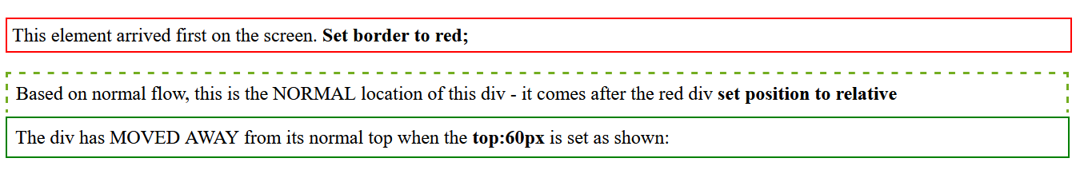
RELATIVE POSITIONING
This means an element is positioned relative to its “normal” position, other contents will not take any gap left by it.
Setting the top, right, bottom, and left properties of a relatively positioned element will cause it to be adjusted away from its normal position. Other content will not be adjusted to fit into any gap left by the element.

Slide 5
<div style="border: 2px solid red; width: 500px; margin: auto; height: 100px;">div 1</div>
<div style="border: 2px solid green; width: 500px; margin: auto; height: 100px; position: relative; top: 30px;">div 2</div>
<div style="border: 2px solid blue; width: 500px; margin: auto; height: 100px;">div 3</div>
NOTE: if the element shifts as a result of the top, left, bottom, right specifications, other contents will not take any gap left by it as long as position: relative;
QUIZ: Try the other sides too, try bottom, left and right too while position is set at relative

Slide 6
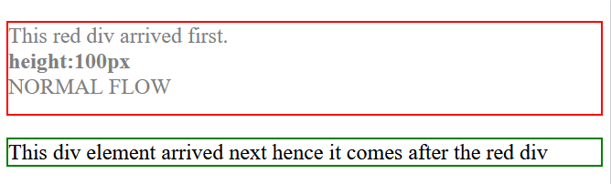
FIXED POSITIONING
An element with position: fixed; is positioned relative to the viewport, which means it always stays in the same place even if the page is scrolled. The top, right, bottom, and left properties are used to position the element.
A fixed element does not leave a gap in the page where it would normally have been located.

Slide 7
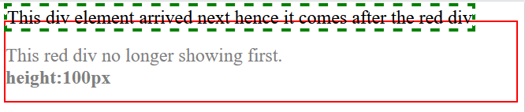
What happens if any of top, right, bottom or left is set for a position:fixed? The element moves away relative to the viewport
NOTE: It means the positioned element always stays in the same place even if the page is scrolled. It does not leave gap in the page where it would have been created. It is also no longer rigid on 100% width again unless the width is explicitly specified
Exercise: Try specifying the other sides(bottom, right, left) too while position :fixed
.greendiv {position: fixed; top:0px};

Slide 8
ABSOLUTE POSITIONING
An element with position: absolute; is positioned relative to the nearest positioned ancestor (instead of positioned respect to the viewport, like fixed).
However; if an absolutely positioned element has no positioned ancestors, it uses the document body, and moves along with page scrolling.
Note: An absolutely positioned elements are removed from the normal flow, and can overlap elements.
What happens if any of the top, right, bottom, or left is set? The element moves away relative to its “parent”
For the element to measure the distance away from these sides, however, its parent must be positioned too (any position other than static must be set on their parent)
If the parent is not positioned, it will use its closest positioned ancestor or the body tag if none is found

Slide 9
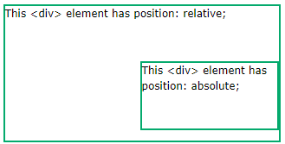
div.parent {
position: relative;
width: 400px;
height: 200px;
border: 3px solid #73AD21;
}
div.child {
position: absolute;
top: 80px;
right: 0;
width: 200px;
height: 100px;
border: 3px solid #73AD21;
}

Slide 10
Class Exercise:
Create a div tag and place an image within the div
Let the image be 100% width (to fill up the div)
Using the absolute positioning, place an h1 tag on the page and position it in such a way that it will sit on the image (you may give the h1 a brighter color for easy recognition)

Slide 11
STICKY POSITIONING
A stickily positioned element is treated as relatively positioned until it crosses a specified threshold, at which point it is treated as fixed until it reaches the boundary of its parent.
Note: Internet Explorer does not support sticky positioning. Safari requires a -webkit- prefix (see example below). You must also specify at least one of top, right, bottom or left for sticky positioning to work.
Sticky positioning can be thought of as a hybrid of relative and fixed positioning.
You must specify a threshold* with at least one of top, right, bottom, or left for sticky positioning to behave as expected. Otherwise, it will be indistinguishable from relative positioning.

Slide 12
CSS Z-index
Positioning may cause elements to overlap on each other
The z-index specifies the stack order of an element (should they overlap). An element can have a negative or positive z-index value.
Higher z-index values bring elements closer to the viewer, while lower values push them further back.
When not set, the default z-index value for page elements is 0, elements with a negative z-index value appear behind elements without a set z-index value
The element must be positioned before it can respond to z-index;
NOTE: Z-index only works on positioned elements.

Slide 13
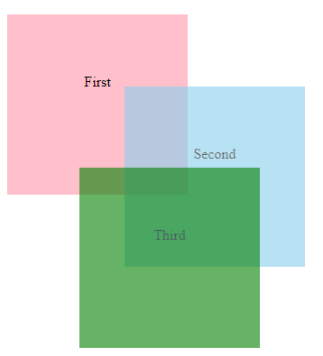
Exercise: Achieve the stack shown using positioning:
Hint: z-index, positioning, transparency.

Slide 14

CLASS EXERCISE - Create something similar to this: A part of a real website:

Slide 15
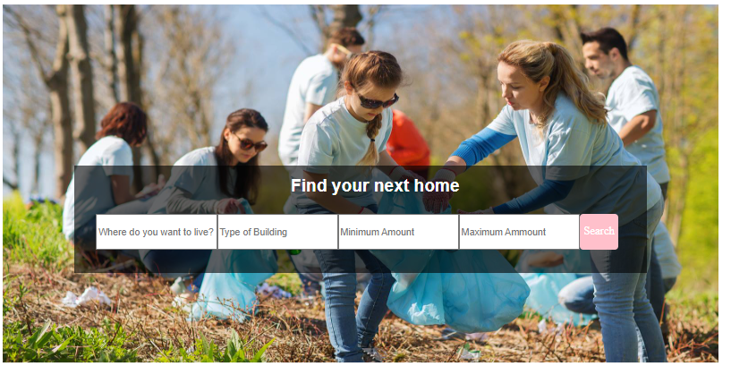
Assignment: Try achieving this layout using everything you have learnt so far. Use any similar photo.

